Slide 1
How do risk assessment and governance support new build safety?
Elise Maynard

Slide 2
Objectives
Key governance documents
Risk assessment of new builds
Summary

Slide 3
Legislation and Guidance in Relation to Water Management
Health & Safety at Work etc. Act 1974
Management of H&S at Work Regulations 1999
COSHH Regulations 2002
Corporate Manslaughter & Corporate Homicide Act 2007
Health & Safety Sentencing Guidelines 2016

Slide 4
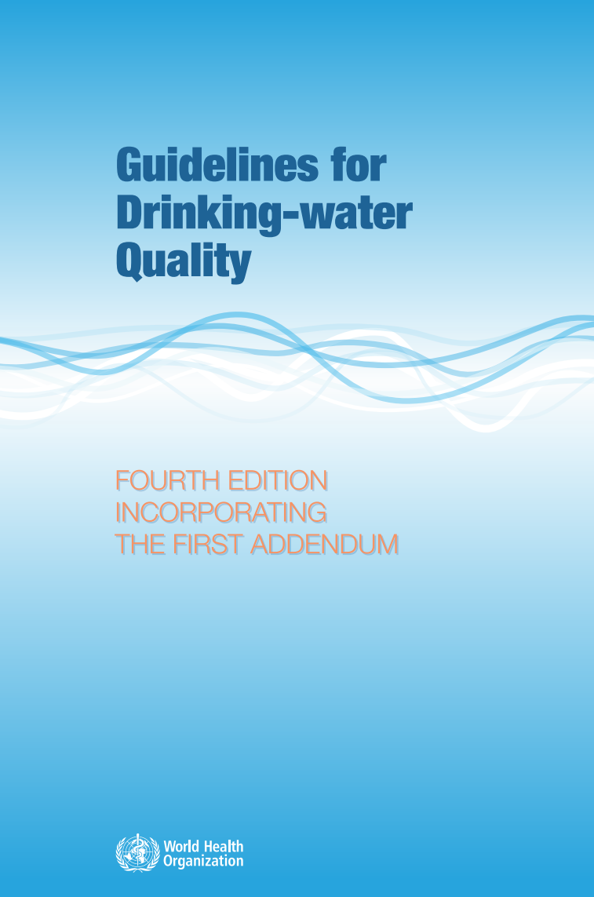

Drinking Water Quality
The Water Supply (Water Quality) Regulations 2016
Drinking water is not sterile
  nor does it need to be
Must meet requirements for wholesome or potable water
  Tested for faecal pathogens
  E. coli, coliforms etc
Legionella or Pseudomonas testing
  not mandatory (yet!)
https://www.legislation.gov.uk/uksi/2016/614/contents

Slide 5
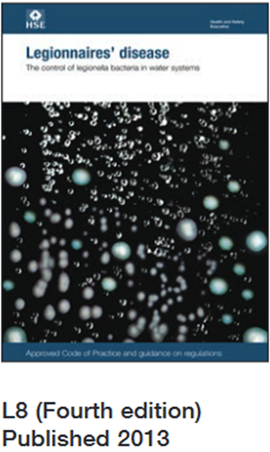

ACoP L8 & HSG 274
Legionella specific
Conduct Risk Assessments
Prevent or control exposure
Maintain, check and test control measures
Provide information, instruction & training
Water Safety Groups & Plans (BS 8680:2020)

Slide 6
Healthcare Legislation
Health & Social Care Act 2012
  NHS Constitution
Health & Social Care Act 2008 (Regulated activities 2014)
  HCAI code of practice
CQC Regulations
  CQC standards

Slide 7
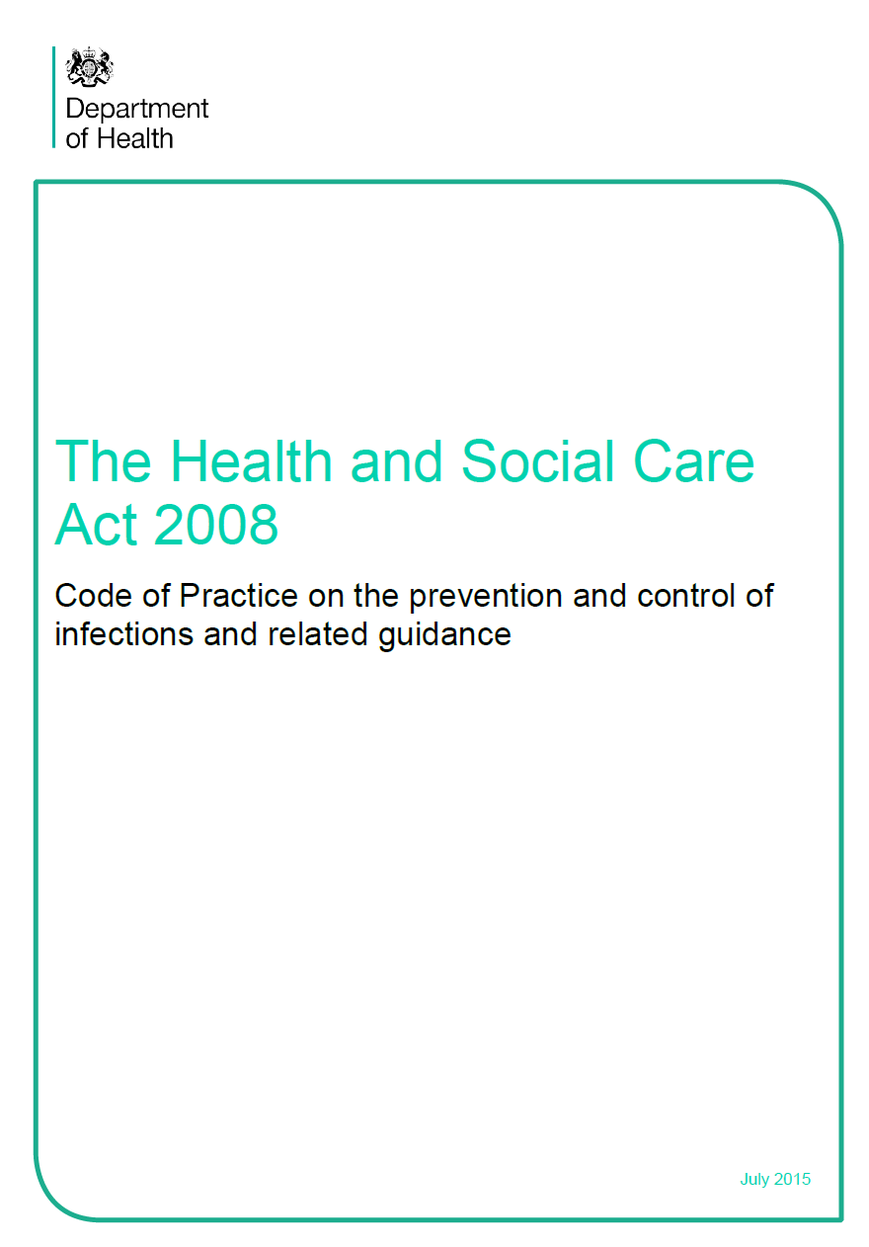
Health & Social Care Act 2008
Code of Practice
Part 1 Sets out who the Act applies to:
NHS bodies, providers of independent healthcare & adult social care in England e.g.
  primary dental care
  independent sector ambulance providers
  primary medical care providers
Notes:
This Code of Practice was issued in 2015 and comprises 4 parts.
Part 1 of the code explains that the Health and Social Care Act (2008) applies to registered providers of all healthcare and adult social care in England.

Slide 8

Health & Social Care Act 2008
Code of Practice
Part 2 – The Code of Practice
10 criteria against which the CQC judge registered providers on compliance with infection prevention requirements
  Includes risk assessment
Notes:
Part 2 sets out the 10 criteria against which the Care Quality Commission (CQC) will judge a registered provider on how it complies with the infection prevention requirements, which is set out in regulations. The criteria include management and risk assessment, maintaining clean environment, appropriate antimicrobial use, providing information to users and others, ensure risk of transmission of infection to others is reduced , systems to ensure all workers understand and discharge their responsibilities, provide secure isolation facilities, secure laboratory support, have and adhere to policies for care and control of infection, and have a system in place to manage occupational health of staff.

Slide 9
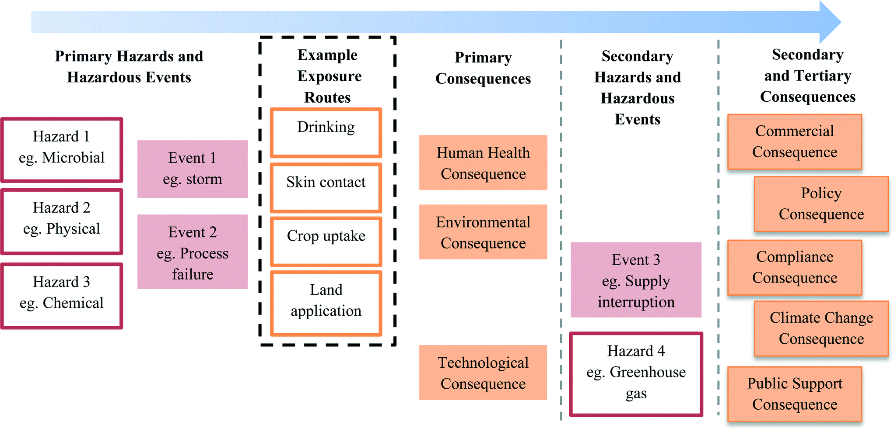
Health & Social Care Act 2008
Code of Practice
Parts 3 & 4
Aid registered providers to interpret the Code and set out criteria to enable them to develop their own risk assessments
  with examples of proportionality
Requirement to create WSGs & WSPs
Notes:
Parts 3 and 4 help registered providers to interpret the criteria and develop their own risk assessments. The appendices provide examples of how a proportionate approach could be applied to the criteria in all sectors.
The law states that the Code must be taken into account by the CQC when it makes decisions about registration against the infection prevention requirements. The regulations also say that providers must have regard to the Code when deciding how they will comply with registration requirements. So, by following the Code, registered providers will be able to show that they meet the requirement set out in the regulations.
However, the Code is not mandatory so registered providers do not by law have to comply with the Code. A registered provider may be able to demonstrate that it meets the regulations in a different way (equivalent or better) from that described in the document.

Slide 10
Health Technical Memoranda
HTM 00 Building engineering in the health sector
HTM 04-01 Safe water in healthcare premises
HTM 07-04 Water management and efficiency
HTM 01-05 Primary care dental practices
https://www.gov.uk/government/collections/health-technical-memorandum-disinfection-and-sterilization
Notes:
The Health Technical Memoranda (HTMs) give comprehensive advice and guidance on the design, installation and operation of specialised building and engineering technology used in the delivery of healthcare.
The focus of Health Technical Memorandum guidance remains on healthcare-specific elements of standards, policies and up-to-date established best practice. They are applicable to new and existing sites and are for use at various stages during the whole building lifecycle.
Healthcare providers have a duty of care to ensure that appropriate governance arrangements are in place and are managed effectively. The Health Technical Memorandum series provides best practice engineering standards and policy to enable management of this duty of care.

Slide 11
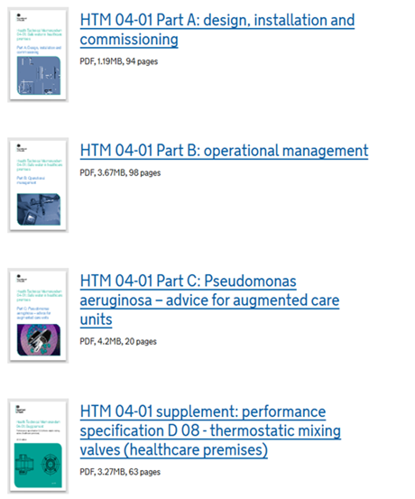
HTM 04-01
Safe Water in Healthcare Premises
Conduct Risk Assessments
Prevent or control exposure
Maintain, check & test control measures
Provide information, instruction & training
Water Safety Groups & Plans
https://www.gov.uk/government/publications/hot-and-cold-water-supply-storage-and-distribution-systems-for-healthcare-premises

Slide 12
Health Building Notes
HBN 00-09 Infection control in the built environment
HBN 00-10 Part C: Sanitary Assemblies
https://www.gov.uk/government/collections/health-building-notes-core-elements
Notes:
Health building notes give best practice guidance on the design and planning of new healthcare buildings and on the adaptation or extension of existing facilities. They provide information to support the briefing and design processes for individual projects in the NHS building programme.

Slide 13

Industry Specific Guidance
BSRIA 8 stage planning process
  How does water management fit?
  How is water safety defined?
  How are patient risks defined?
  Do the design teams and contractors fully understand water safety?
  Is there a design risk assessment?
  Who oversees quality of delivery?
https://www.bsria.com/uk/product/4BR46n/building_services_job_book_a_project_framework_for_engineering_services_bg_12009_a15d25e1/

Slide 14

Risk Assessing for Water Hygiene

Slide 15

BS 8580-1

Slide 16
BS 8580-2
Water quality – Part 2:
Risk assessments for Pseudomonas aeruginosa and other waterborne pathogens – Code of practice

Slide 17
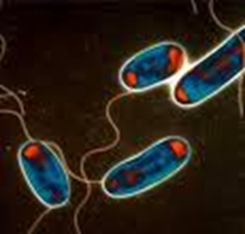
Waterborne Pathogens
Legionella spp.
Pseudomonas aeruginosa
Pseudomonads
  Stenotrophomonas maltophilia
  Elizabethkingia meningoseptica
  Burkholderia cepacia complex
Klebsiella spp.
Non-tuberculous mycobacteria (NTM)
Image courtesy of Eukaryotica

Slide 18
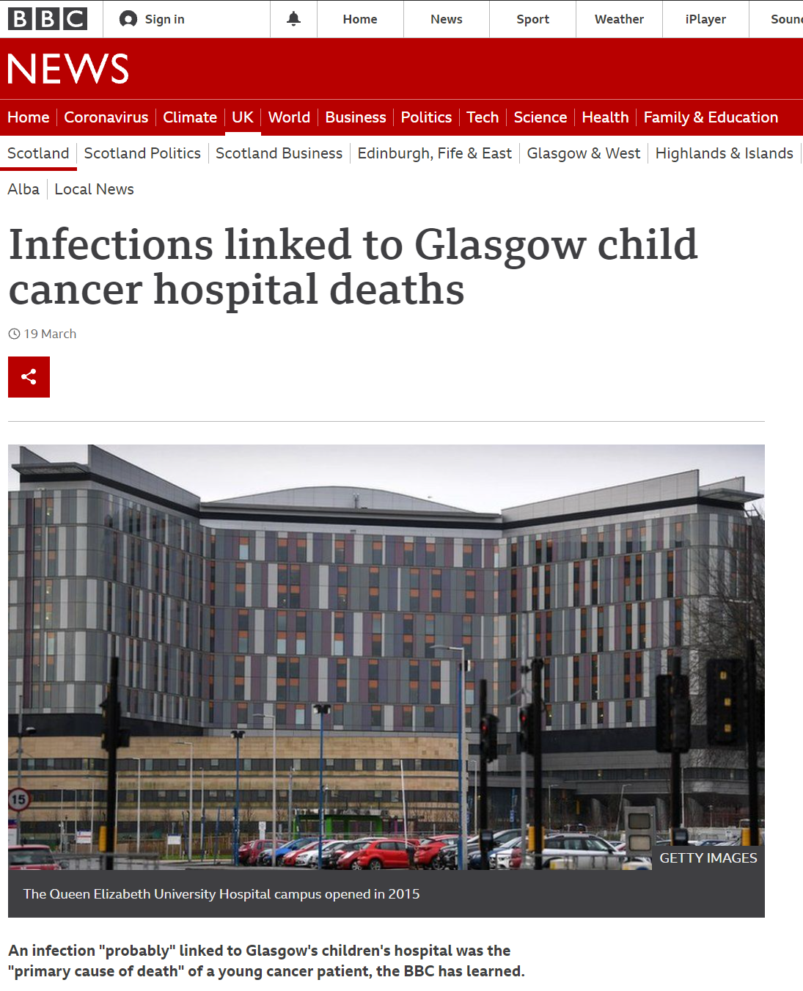
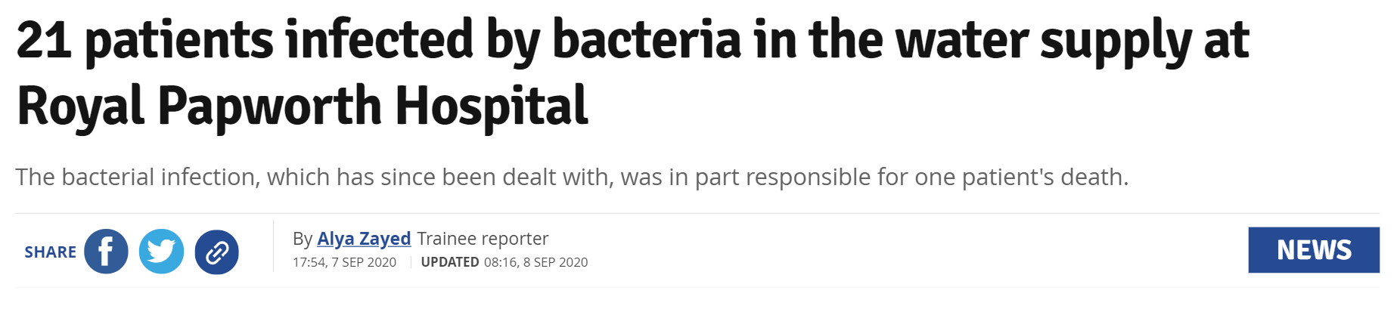
“Emerging Organisms”
Notes:
More than 20 patients were infected by a bacteria potentially found in the water supply at a Cambridge hospital, with one patient dying as a result.
In the months after moving to the new Royal Papworth Hospital site in May last year, 21 patients were victim to a bacterial outbreak, which played a role in the death of one patient.
The bacteria, mycobacterium abscessus, could have come from the water supply, said the hospital trust.
The source of the infection has been found and dealt with, so it is no longer a risk to current patients.
The bacteria is not harmful to most people, except for those with lung conditions.
Research carried out in 2020/2021
Throughout 2020/2021 the NHS Scotland Assure Research service commissioned a number of research projects which address gaps in current evidence. These relate to previous issues and lessons learned within previous NHS Scotland projects.
The research projects carried out to date are as listed below with final outputs due by end July 2021:
to investigate the prevalence and concentration of Cupriavidus and other Opportunistic Premise Plumbing Pathogens (OPPPs) in healthcare water systems across Scotland and England. Chief Investigator: Teresa Inkster, NHS Greater Glasgow & Clyde
hospital sinks and drains as a source of antimicrobial resistant microorganisms: studies to investigate colonisation, dispersal and decontamination. Chief Investigator: Ginny Moore, Public Health England
whole genome sequencing of potable water derived Cupriavidus species.

Slide 19
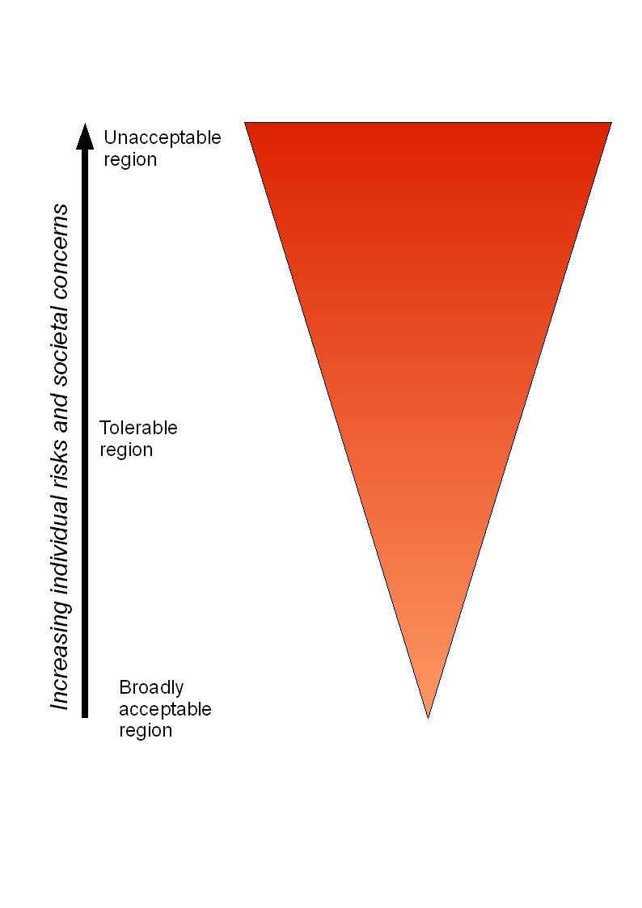
Risk Assessment Process
CATES | ALARP
Contamination | As
Amplification | Low
Transmission | As
Exposure | Reasonably
Susceptibility | Practicable
Image courtesy of David W. Legg
Notes:
ALARP

Slide 20
Contamination

Slide 21
Evidence of Contamination
Check existing environmental and clinical surveillance results:
Legionella
Pseudomonas aeruginosa
Total Viable Counts (TVC)
E. coli
Coliforms
Clusters of resistant bacteria

Slide 22

Amplification

Slide 23
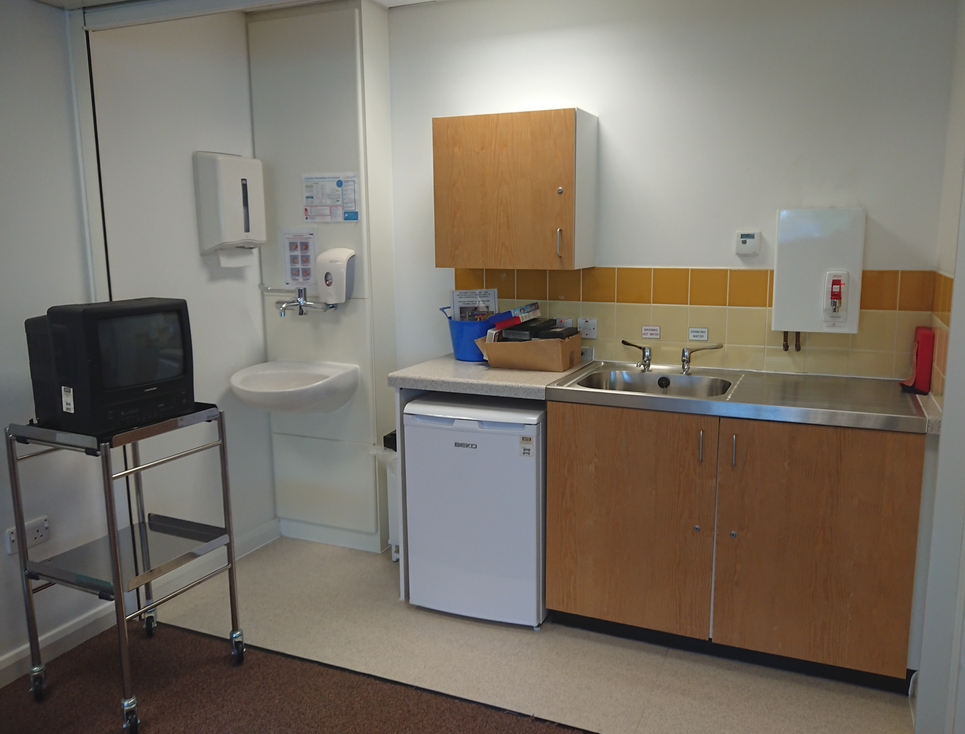
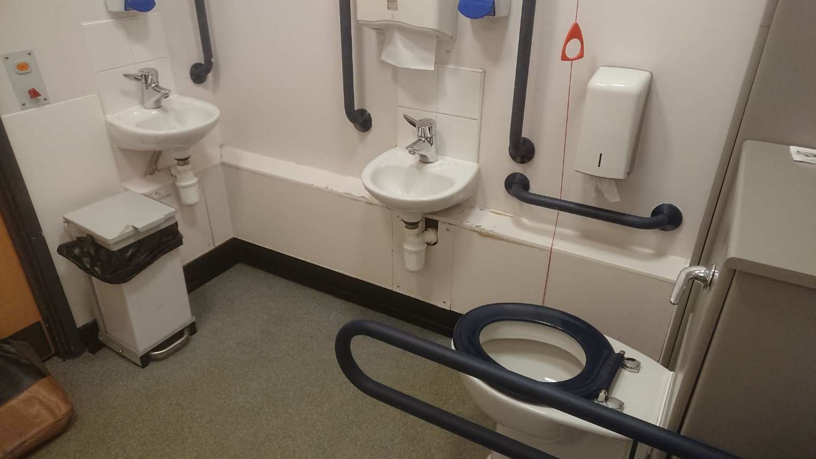
Design

Slide 24

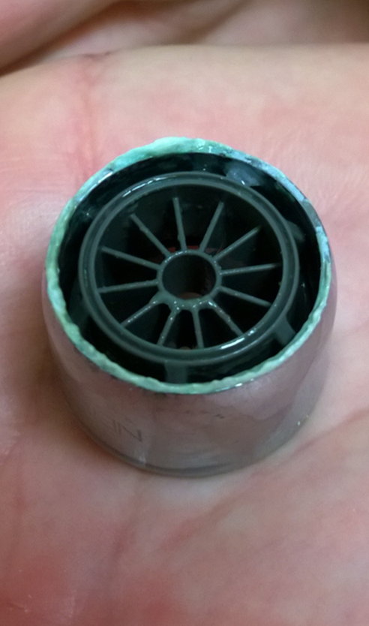

Unsuitable Materials

Slide 25
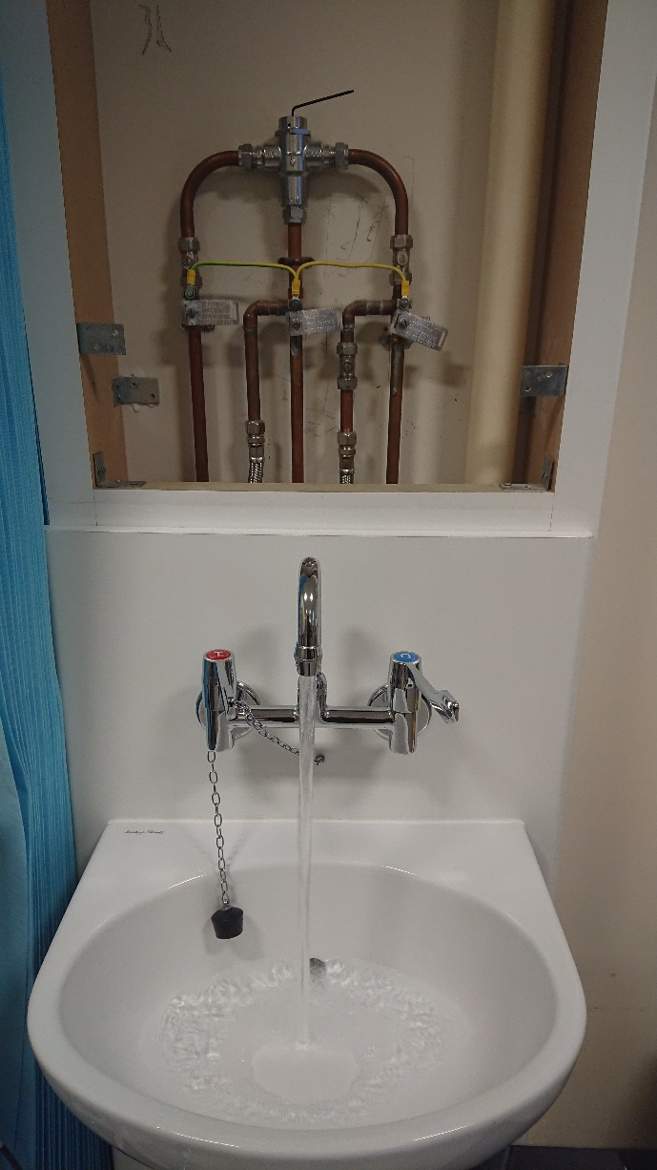
Controls
Uncontrolled temperatures/chemicals
Stagnation of water – deadlegs
Stagnation of water – low outlet use
Poor hygiene or cleaning at points of use

Slide 26
Transmission

Slide 27
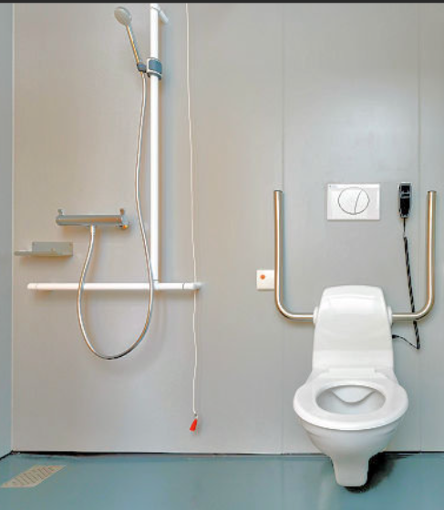
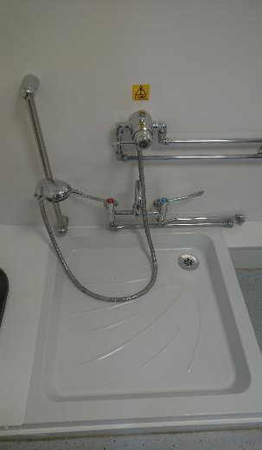
Inhalation

Slide 28

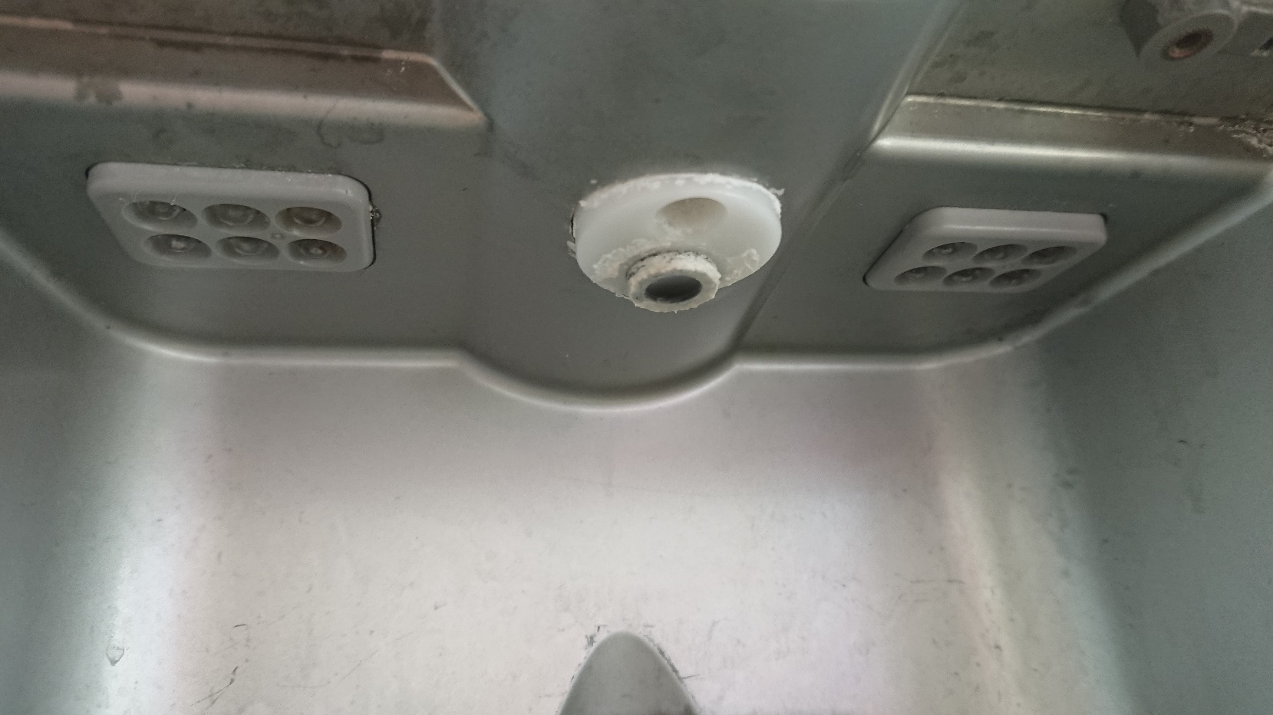
Ingestion
Water Cooler
Image kind permission of de:Benutzer:Alex Anlicker

Slide 29
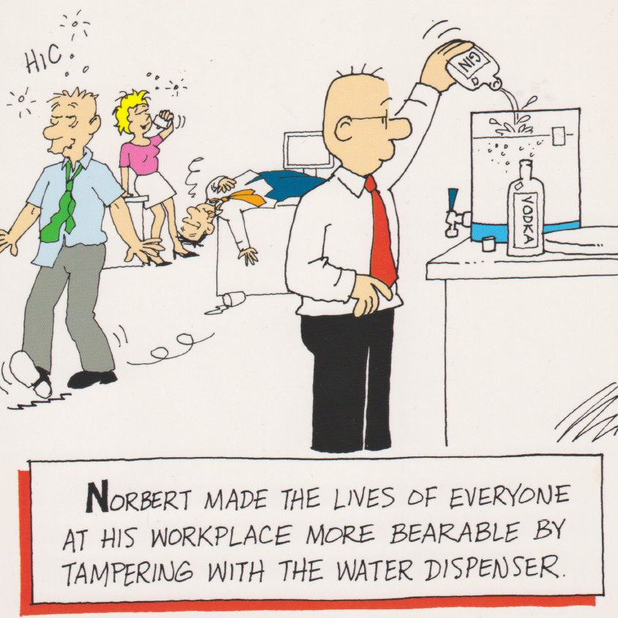

Slide 30
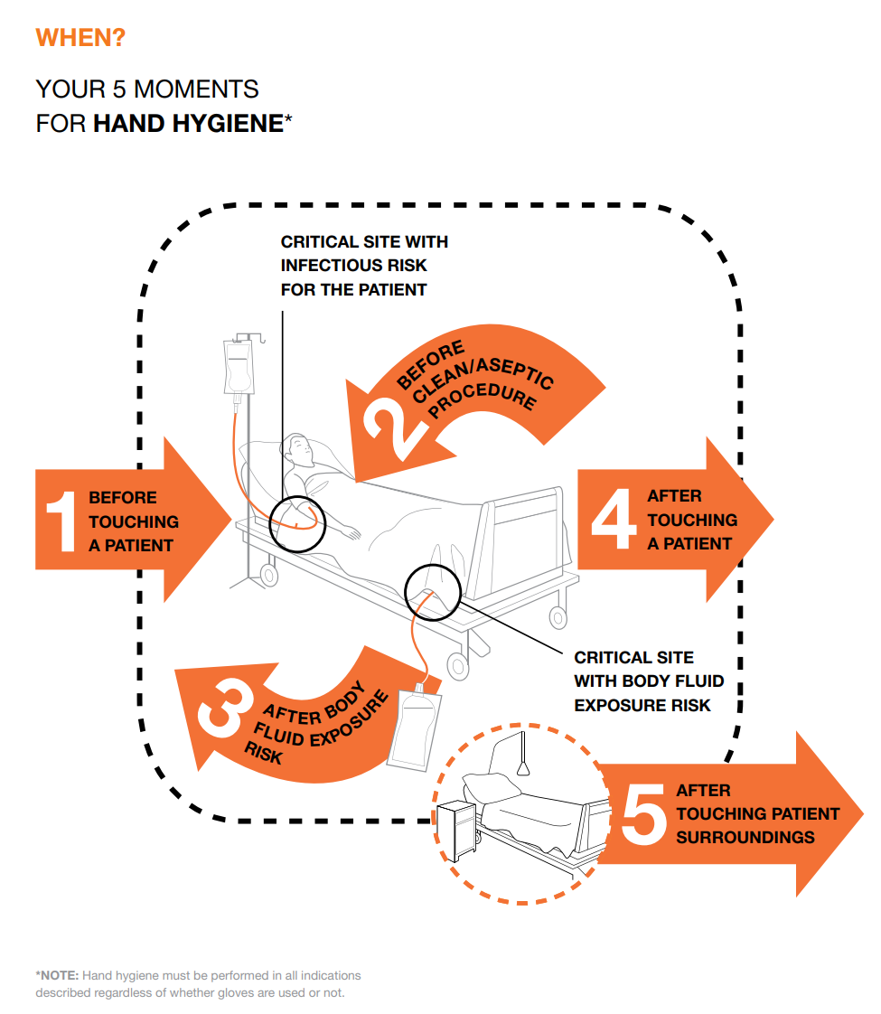
Contact

Slide 31
Exposure

Slide 32
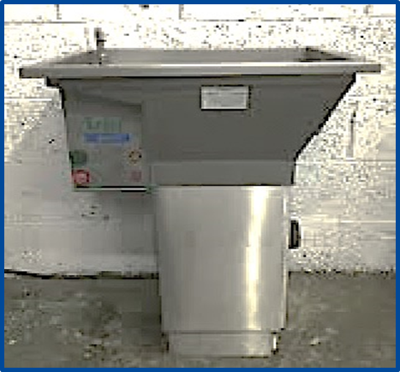
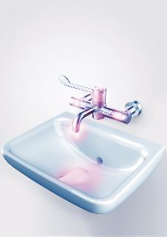
Blockage & Splashing

Slide 33
Susceptibility

Slide 34
Susceptibility
Health Risk
Age
Disease
Treatment
Gender
Augmented care

Slide 35
Healthcare Acquired Infections
Estimated total annual cost in UK - £774 million (328m -2,192m)
  Evaluation of Cost of Nosocomial Infection (ECONI) study
Estimated 20% are water-based
  equates to £100 million/year
Manoukian et al. Journal of Hospital Infection 114 (2021) 43e50

Slide 36
Summary
There are many sources to aid Governance
Water hygiene training should be suitable and sufficient for ALL members of the design and delivery teams
A team approach is vital – involve the WSG from the outset
Heathcare Associated Infections are numerous and costly
© Elise Maynard & Associates LLP 2021

